Slide 1
Top Selling Books
Domine: Marketing

Slide 2
Problem statement:
1)How has the distribution of best-selling fiction and nonfiction books evolved throughout time?
2) See what the reviews of different genres are trending for each year?
3) To determine which genres have the highest annual costs?
4) Find the user ratings for each year's genres?
5) Which author's books were more popular each year?
6)To find the correlation of all the columns ?
7) How many of the author's books have been sold?
8)Which book have highest rating?

Slide 3
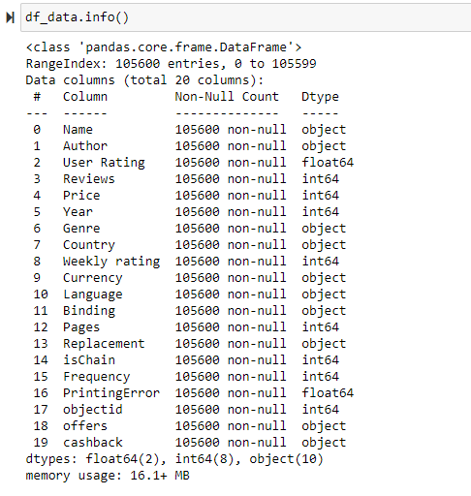
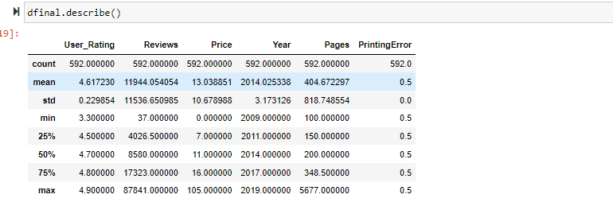

Slide 4
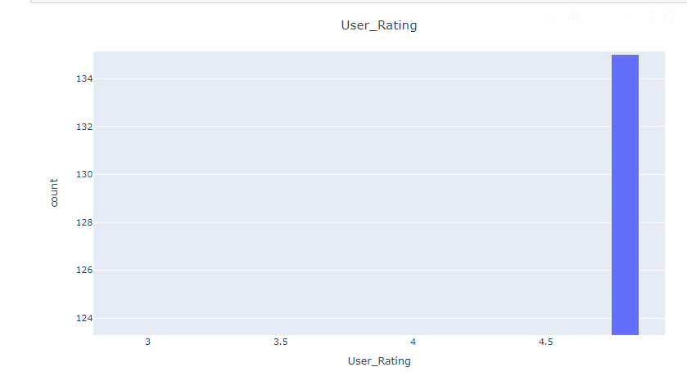
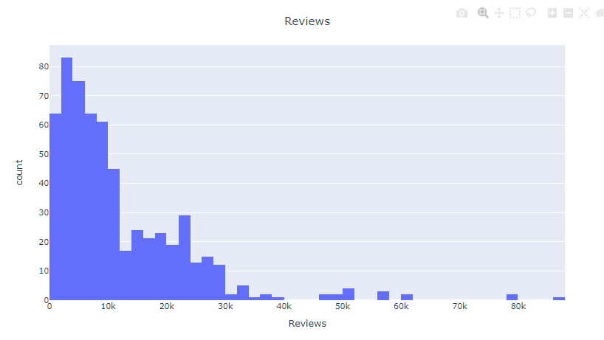
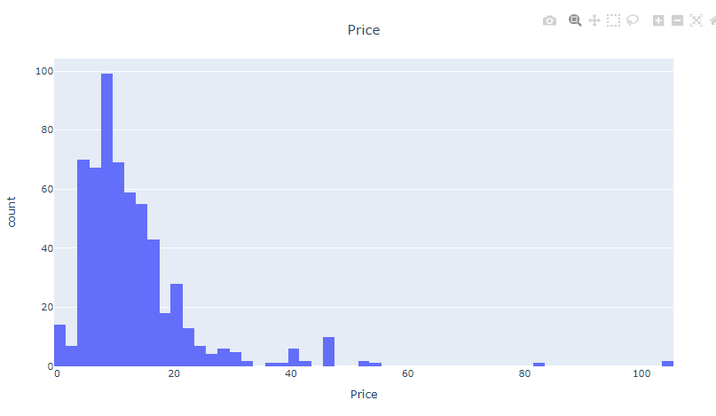
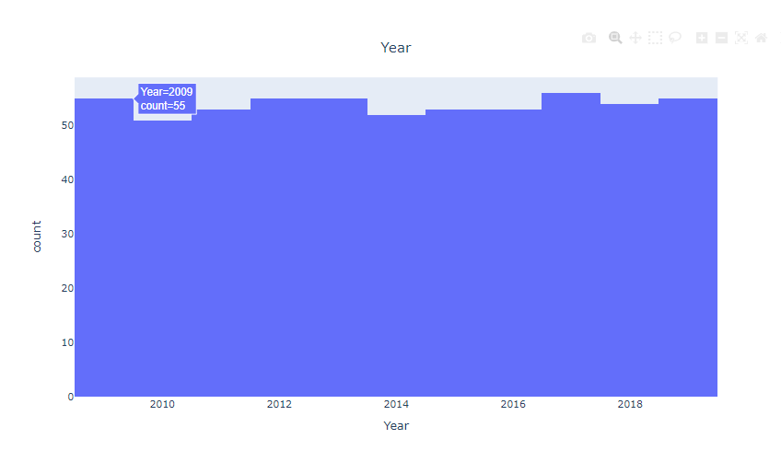

Slide 5
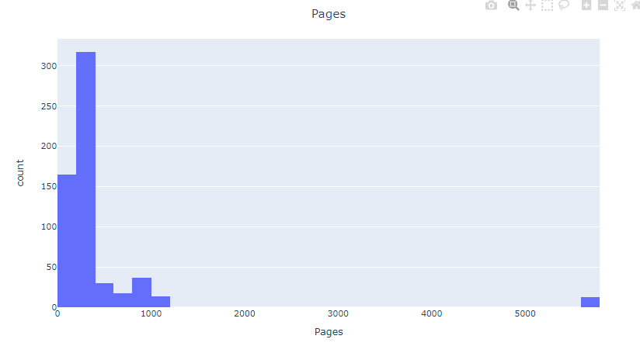
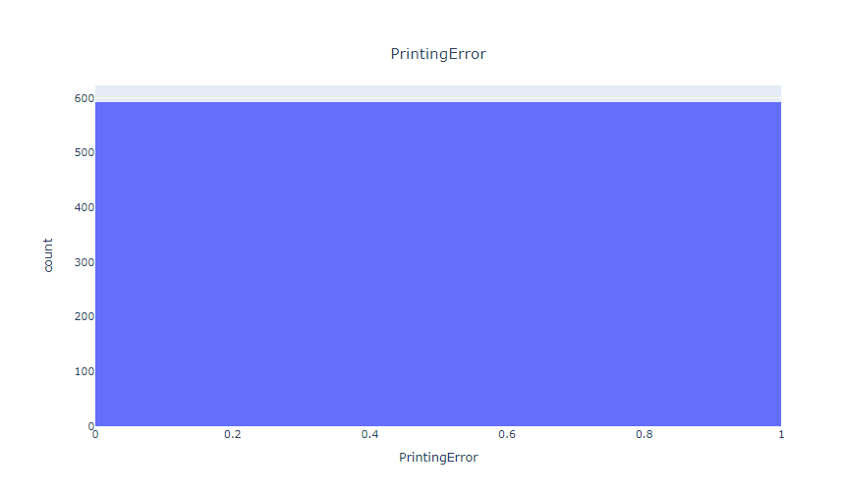

Slide 6
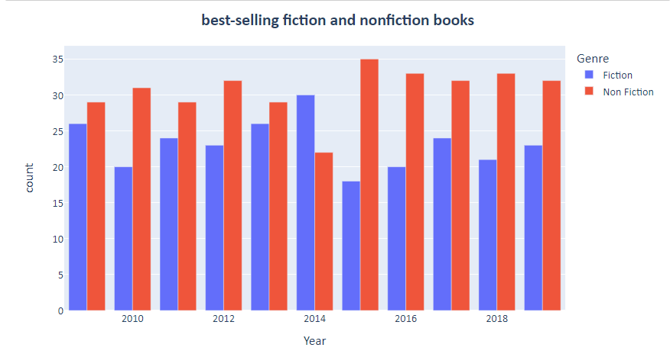
Case:1 -How has the distribution of best-selling fiction and nonfiction books evolved throughout time?

Slide 7
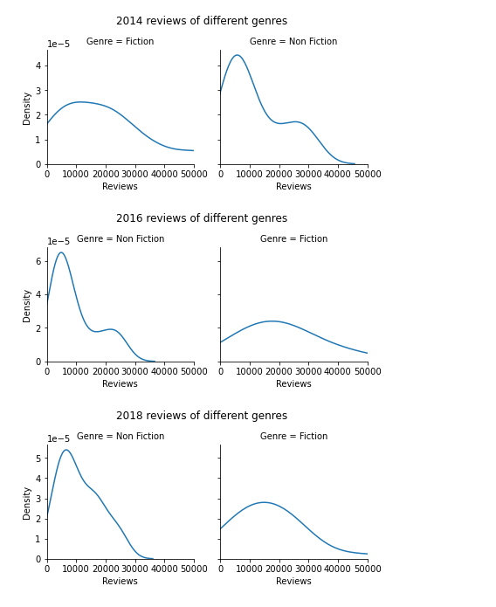
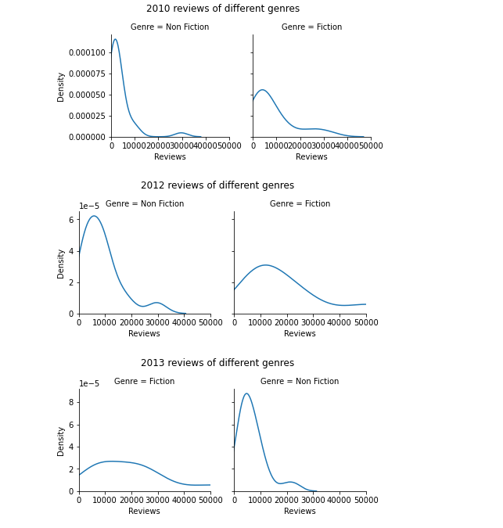
2) See what the reviews of different genres are trending for each year?
Case:2 -See what the reviews of different genres are trending for each year?

Slide 8
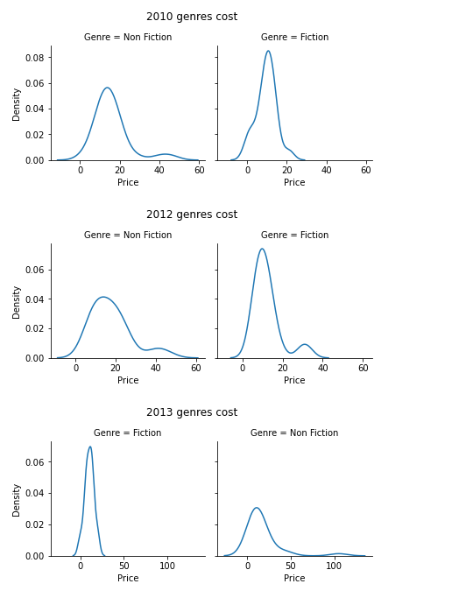
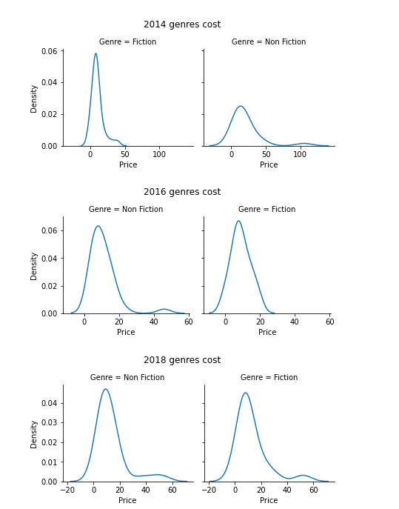
Case:3 -To determine which genres have the highest annual costs?

Slide 9
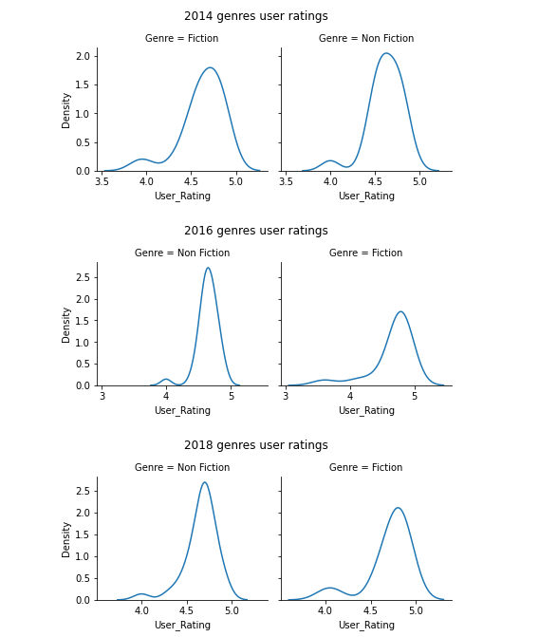
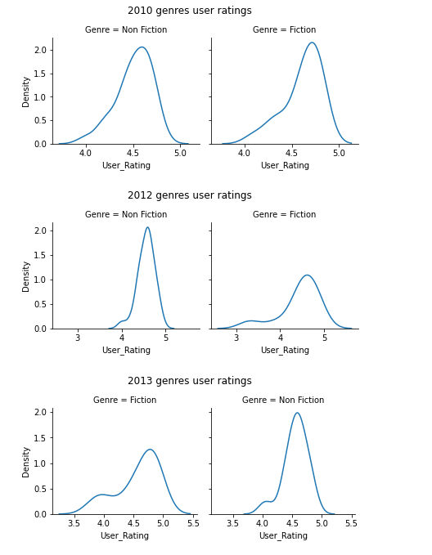
Case-4:Find the user ratings for each year's genres?

Slide 10
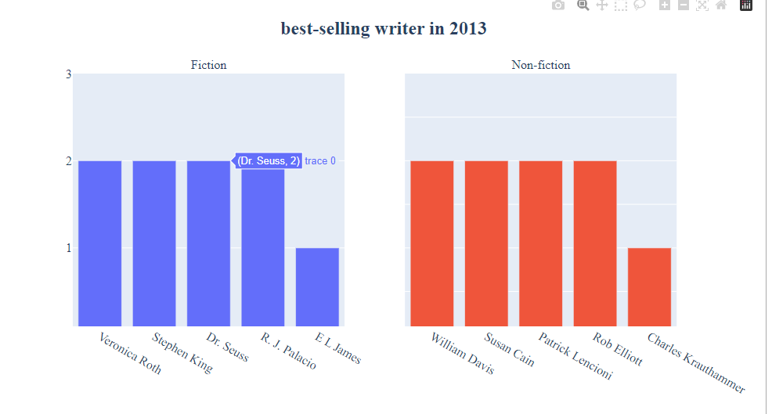
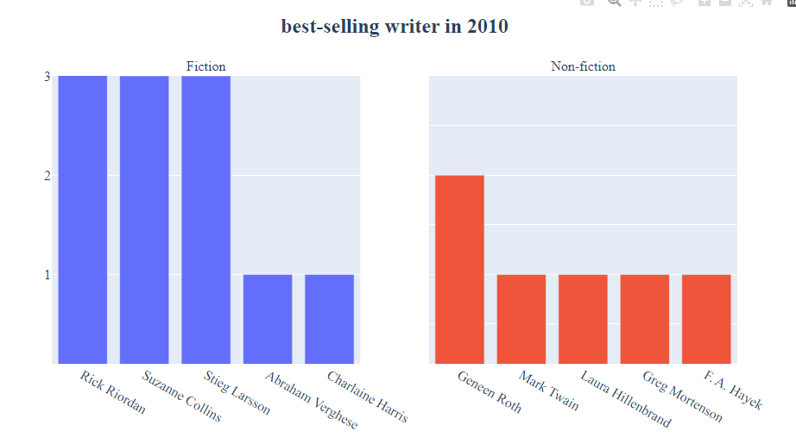
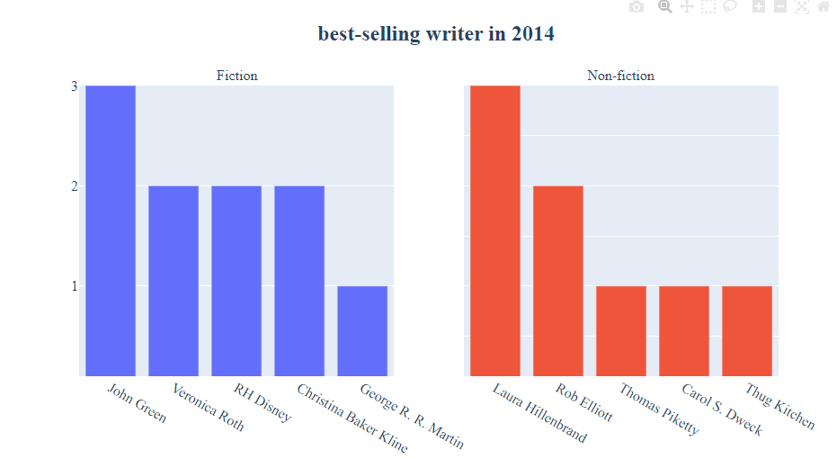
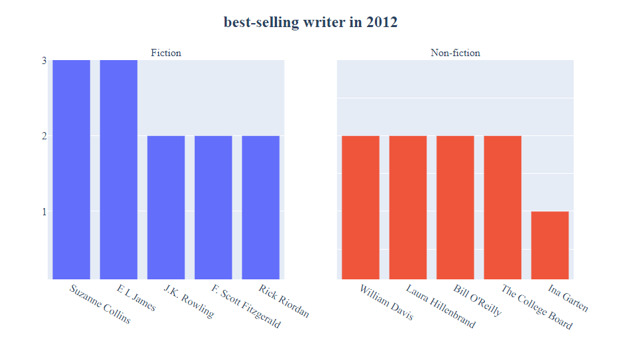
case:5 - Which author's books were more popular each year?

Slide 11
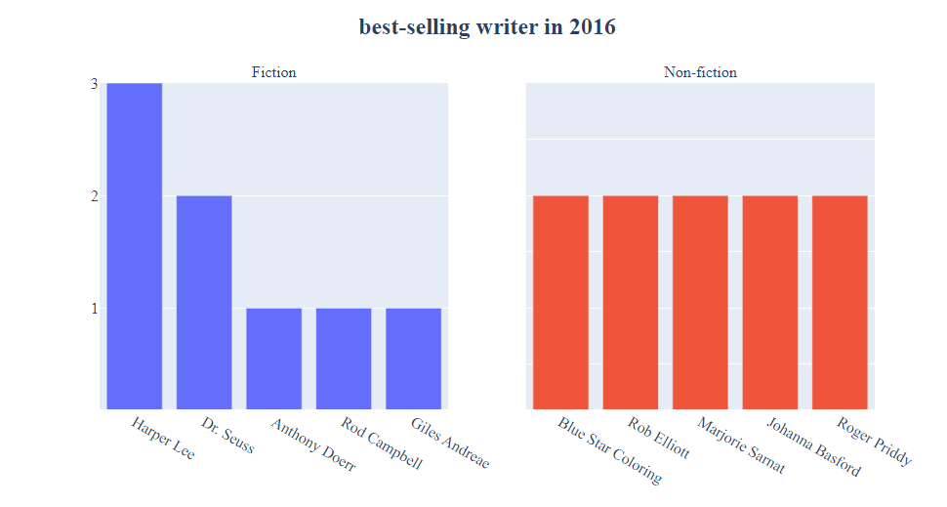
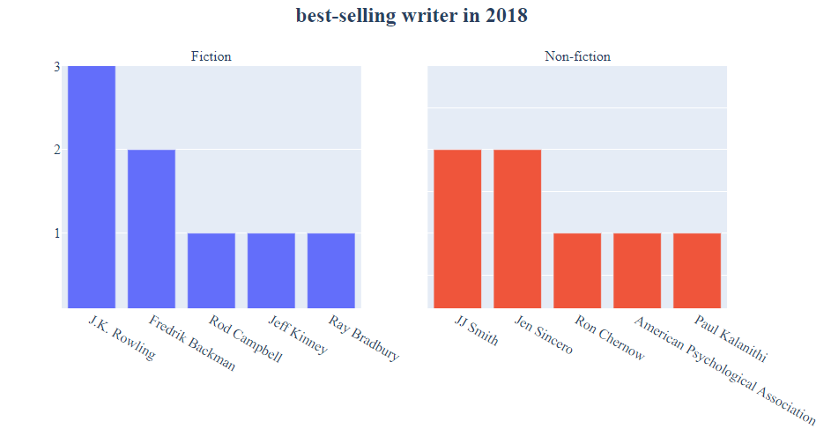

Slide 12
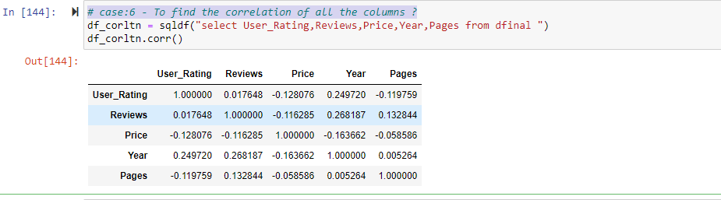
case:6 - To find the correlation of all the columns ?

Slide 13
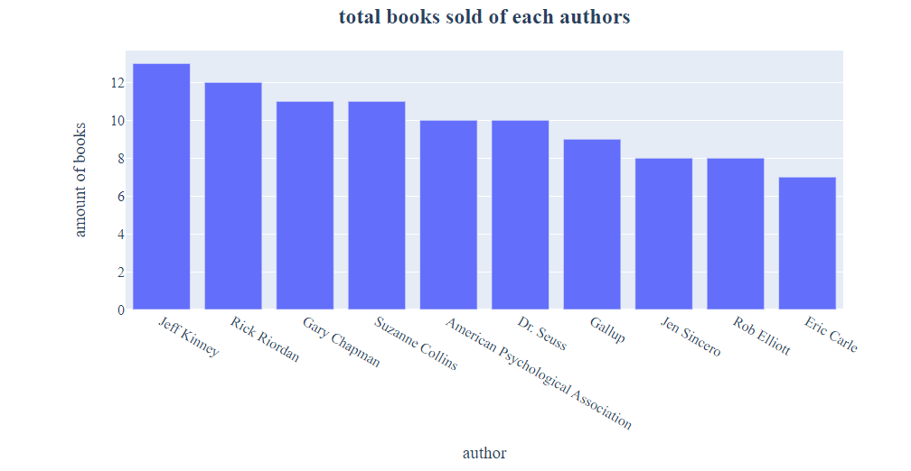
case:7 - How many of the author's books have been sold?

Slide 14
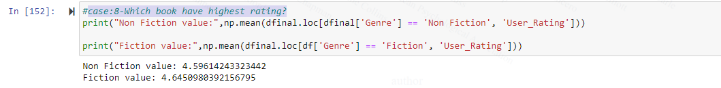
case:8-Which book have highest rating?

Slide 15
Thank You

